Slide 1
Chapter 5
Scope and Segments in Wellness in Food Service, Hospitality and Tourism
Dr. Bendegul Okumus
Heather Linton Kelly

Slide 2
Learning Outcomes
Discuss the case study of Big Sky Yoga Retreats
Define segmentation and explain different types of segmentation in wellness
Discuss the scope and segments of wellness in hospitality and tourism
Explain whether and how wellness travelers are different
Offer suggestions on how food service, hospitality and tourism businesses can segment their wellness customers

Slide 3


Case Study: Big Sky Yoga Retreats
Click to watch: https://www.facebook.com/bigskyyogaretreats/videos/623325585109470/

Slide 4
Scope & Segments in Food Service, Hospitality & Tourism
Segment | Value (in USD billions)
Personal Care, Beauty, and Anti-Aging | $1,083
Healthy Eating, Nutrition, and Weight Loss | $702
Wellness Tourism | $639
Fitness and Mind-Body | $595
Preventive and Personalized Medicine and Public Health | $575
Traditional and Complementary Medicine | $360
Wellness Real Estate | $134
Spa Economy | $119
Thermal/Mineral Hot Springs | $56
Workplace Wellness | $48
Total | $4.2 Trillion

Slide 5
Segmentation
Segmentation: The process of defining and subdividing a large homogenous market into clearly identifiable segments having similar needs, wants, or demand characteristics
Segment: A cluster of similar customers grouped together based on shared characteristics

Slide 6
Types of Segmentation
 | Demographic | Psychographic | Behavioral
Definition | Classification based on individual attributes | Classification based on attitudes, aspirations, values, etc. | Classification based on actual behaviors
Examples | Geography Gender Race Social class Age Ethnicity Education Level Occupation Income Level Family Status Religion Generation | Psychographic lifestyle Personality Traits Values Opinions Interests | User status Usage Rate Benefits Sought Occasion Purchase Decision Loyalty Status Attitude
Decision Criteria | Target customers based on country of residence, age, gender, affluence, family status | Target customers based on values or lifestyle | Target customers based on purchase behavior, usage behavior, or benefits sought
Difficulty | Simpler | More advanced | More advanced

Slide 7
Psychographic: Big 5 Personality Traits
 | High Low
Openness | Very creative Open to trying new things Enjoys new challenges Likes abstract concepts | Not very imaginative Dislikes change and new things Resists new ideas Dislikes abstract/theoretical concepts
Conscientiousness | Spends time preparing Finishes important tasks right away Pays attention to detail Likes having a set schedule | Procrastinates important tasks or does not complete them at all Makes messes and doesn't take care of things Fails to return things or put them back where they belong Dislikes structures and schedules
Extraversion | Likes being the center of attention Enjoys meeting new people and starting new conversations Has a wide social circle and finds it easy to make new friends Feels energized when around other people Says things before thinking about them | Dislikes being the center of attention Dislikes making small talk Prefers solitude Finds it difficult to start conversations Feels exhausted when having to socialize a lot Carefully thinks things through before speaking

Slide 8
Psychographic: Big 5 Personality Traits
 | High Low
Agreeableness | Very interested in other people Cares about others Feels empathy and concern for others Enjoys helping and contributing to the happiness of other people Assists others who are in need of help | Takes little interest in others and their problems Doesn't care about how other people feel Insults and belittles others Manipulates others to get what they want
Neuroticism | Experiences a lot of stress Worries about many different things Gets upset easily Has dramatic shifts in mood Feels anxious Struggles to bounce back after stressful events | Emotionally stable Deals well with stress Rarely feels sad or depressed Doesn't worry much Is very relaxed

Slide 9
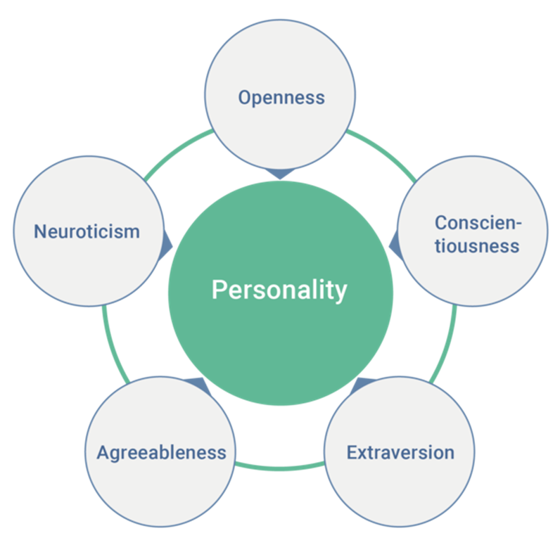
Psychographic: Big 5 Personality Traits
Tunikova, A. (2018) [Five Factor Model] Retrieved January 31, 2020 from https://commons.wikimedia.org/wiki/File:Wiki-grafik_peats-de_big_five_ENG.png

Slide 10
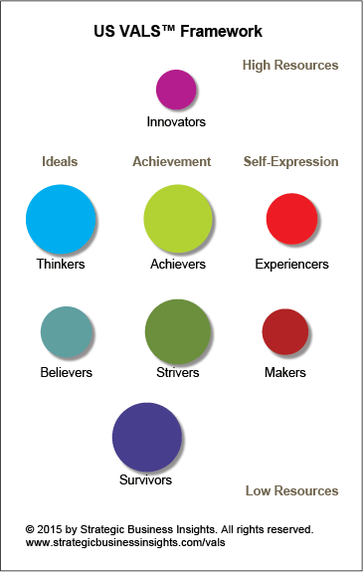
Psychographic: The VALS Segmentation System
Strategic Business Insights. (n.d.). US Framework and VALS Types. Retrieved January 31,2020 from http://www.strategicbusinessinsights.com/vals/ustypes.shtml

Slide 11
Behavioral Segmentation in Wellness
Purchase Behavior: Determines who, what, when, why, how, and where the wellness customer acquires a wellness product
Usage Behavior: How the customer plans to use the wellness product and service:
  Occasion
  Benefits sought
  Loyalty
  Stage in the purchase process

Slide 12

Segmentation using Activities, Interests, and Opinions
This method specifically focuses on lifestyle features as they relate to a product or service
  Activities – work, social events, vacations or hobbies
  Interests – family, food, community, or recreation
  Opinions - education, culture, or social issues
Provides a more well-rounded look at wellness tourists

Slide 13
Practical Use of Segmentation in Wellness
Measurable: It must be possible to measure the size of a segment in terms of number of individuals and their purchasing power
Accessible: It must be possible to reach a segment with the promotional tools (social media, newspaper ads, television commercials, email newsletters, etc.) available to the marketer
Substantial: A segment must be large enough to warrant receiving a different product or marketing message, and it must be worth the investment to target them differently from other segments
Actionable: A segment must be able to act on a marketing message by purchasing a product

Slide 14

How Are Wellness Travelers Different?
Primary wellness travelers are often looking beyond having an engaging experience, and into the realm of self-improvement
  May indicate a higher degree of openness and agreeableness
  May require more emotional attention than a more traditional guest

Slide 15
Segmentation in Wellness Tourism Research
Damijanic (2009)
  High-level wellness, diet and health-oriented, fitness-oriented, and low-level wellness
Konu (2010)
  Sport and nature people interested in technology, home appreciating travelers, family and health-oriented sport and nature people, culture appreciative self developers, material wellbeing appreciatives, and indifferent about travelling and social issues
Hritz, Sidman, and D’Abundo (2014)
  Escapers, after hours, amenity seekers, most unwell, and most well
Suresh, Ganesan, Ravichandran (2017)
  Occupational ailment prevention seekers and regular clients, heredity ailment prevention seekers and new clients, and anti-gaining spirituality seeker and strong review

Slide 16
Summary Statements
Big Sky Yoga Retreats is a great example of segmentation in the hospitality industry.
Segmentation is “the process of defining and subdividing a large homogenous market into clearly identifiable segments having similar needs, wants, or demands characteristics.”
The three major types of segmentation are demographic, psychographic, and behavioral.
Demographic variables include location, gender, age, ethnicity, education level, and income.

Slide 17
Summary Statements
Psychographic variables include attitudes, aspirations, values, opinions, lifestyle, interests, and personality traits.
A common framework for understanding personality is the Five Factor Model or Big Five personality traits
The Big Five personality traits are openness, conscientiousness, extraversion, agreeableness, and neuroticism.
The VALS Segmentation System is a common psychographic segmentation tool that segments users based on motivation and resources.

Slide 18
Summary Statements
The eight VALS groups are innovators, thinkers, achievers, experiencers, believers, strivers, makers, and survivors.
Psychographic variables include attitudes, aspirations, values, opinions, lifestyle, interests, and personality traits.
Behavioral variables include purchase behavior and usage behavior.
Other important behavioral factors include loyalty, user status, user stage, and decision role.
A customer segment should be measurable, accessible, substantial, and actionable.

Slide 19
Summary Statements
Packaging is combining related services into a single offer for the tourist.
The same traveler can fall into multiple segments depending on where they fit demographically, pyschographically, and behaviorally during their trip.
Primary wellness travelers look to having engaging experiences well improving their wellbeing during travel.
Several wellness tourism research studies have successfully segmented wellness tourists.

